Slide 1
Learning from Bare Bones
with Episodic Memory
Andrew Nuxoll
10 June 2016

Slide 2
Given Long Term Knowledge
Foundational
Hidden/Implicit
What actions are possible
When each action is possible (propose)
How to perform each action (apply)
Value scope
Value bins
Value relevance
Configuration values
Environment limitations
Additional
Preferences
Deductions

Slide 3

Human Experiment
http://bit.do/epmem

Slide 4
Underlying Environment
(You’ll find out during the talk)

Slide 5
Resulting Conclusion: To study episodic learning eliminate as much hidden knowledge as you can.

Slide 6
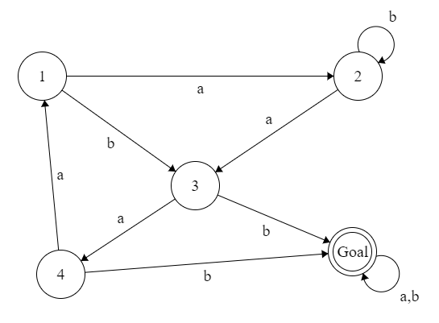
Current Environment
Always path to goal
Random teleport at goal
No sensors other than goal
baabbabaaabbaababaa…

Slide 7
SMS and LMS features
Longest Matching Sequence (LMS)
abdadcadccdabdbdcccabcdbabcddabdcdddacddedccbadcdbcdadcbabddcbabbbaabcbdbabdbcbdbabdbbbdcbbdacbbdabdcccdba
Shortest Unique Sequence (SUS)
Tried so far: a, b, c, d, aa, ab, ac, ad, ba, bb, bc, bd, ca, cb, cc, cd, da, db, dc, dd, aab, abc, abd, …
Haven't tried yet: aac, aad, aba, …

Slide 8
Partial Match
Episodic Memory:
abdadcadccdabdbdcccabcdbabcddabdcdddacddedccbadcdbcdadcbabddcbabbbaabcbdbabdbcbdbabdbbbdcbbdacbbdabdcccdba
Position: 50% match Content: 25% match
adccdabd a,b,c,d,ad,dc,cc,cd,da,ab,bd,adc,
bdcccdba dcc,ccd,cda,dab,abd,adcc, ...

Slide 9
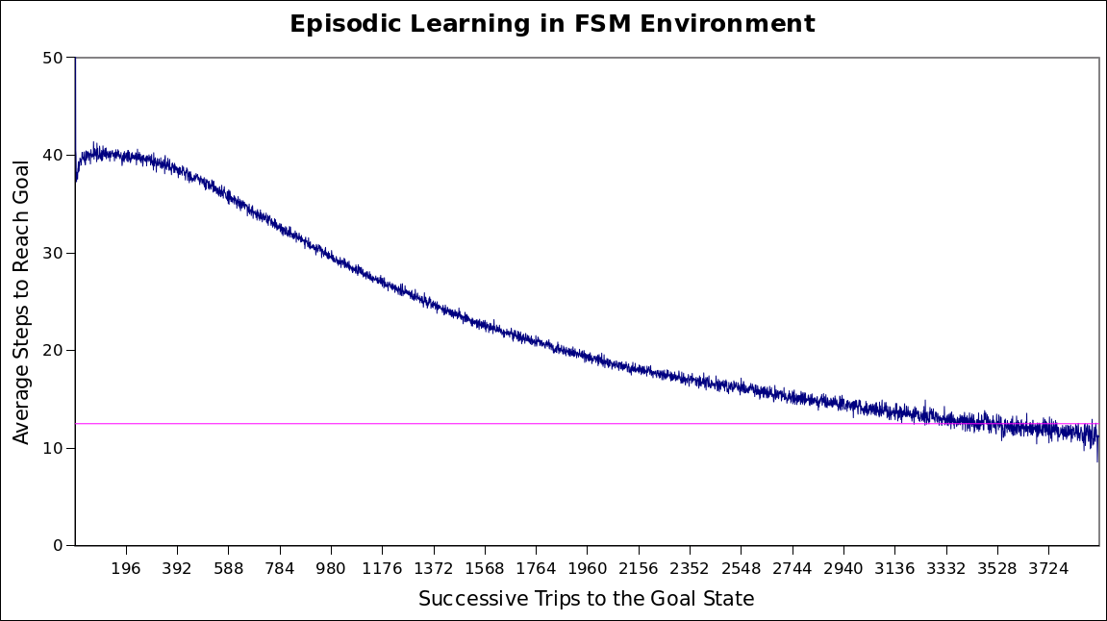
Feature-Based Results

Slide 10
Universal Sequence
Answer: bab

Slide 11
Searching for a Universal Sequence
Begin by trying every sequence:
a, b, c, aa, ab, ac, ba, bb, bc, ca, cb, …
If a particular suffix is successful more than N% of the time, skip others
Repeat for longer and longer suffixes

Slide 12
Universal Sequence Results

Slide 13
Future: Add Sensors
Example: Odd/even numbered states
Separate “universal sequence” for various prefixes
(b,odd)(a,even) → (c,even)(a,*)(b,odd)
Consolidate sensors as states become unique
Hashing?

Slide 14
Future: Other Environments
non-finite
non-deterministic
multiple goals
delayed rewards

Slide 15
Nuggets and Lumps
Gold
Coal
Steady progress
Insightful
Fun
Will it scale?

